Slide 1
Context Free Grammar

Slide 2
Introduction
Syntax addresses the question how sentences are constructed in particular languages
• A grammar is a set of rules that govern the composition of sentences
• Parsing refers to the process of analyzing an word in terms of its structure

Slide 3
Syntax: the way words are arranged together
Grammars (and parsing) are key components in many applications
Grammar checkers
Dialogue management
Question answering
Information extraction
Machine translation

Slide 4
Language Structure and Meaning
We want to know how meaning is mapped onto what language structures.
Commonly in English in ways like this:
[Thing The dog] is [Place in the garden]
[Thing The dog] is [Property fierce]
[Action [Thing The dog] is chasing [Thing the cat]]
[State [Thing The dog] was sitting [Place in the garden] [Time yesterday]]
[Action [Thing We] ran [Path out into the water]]
[Action [Thing The dog] barked [Property/Manner loudly]]
[Action [Thing The dog] barked [Property/Amount nonstop for five hours]]

Slide 5
Theoretical frameworks
Phrase structure grammar
Noam Chomsky (1928–)
Immediate constituent analysis
• Dependency grammar
Lucien Tesnière (1893–1954)
Functional dependency relations
• Categorial grammar
Kazimierz Ajdukiewicz (1890–1963)
Logical derivations

Slide 6
We introduce some sophisticated notions:
❑ Constituency
o Groups of words may behave as a unit – called a constituent.
o Groups of words may behave as a single unit or phrase, called a constituent.
CFG, a formalism allowing us to model the constituency facts
❑ Grammatical relations
o Subjects and objects
❑ Sub-categorization and dependency
o Certain kinds of relations between words and phrases e.g., the verb want can be followed by an infinitival phrase, as in I want to fly to Detroit.

Slide 7
Constituency
A sequence of words that acts as a single unit
Noun phrases
Verb phrases
These units form coherent classes that behave in similar ways
For example, we can say that noun phrases can come before verbs
Constituents tend to have similar internal structure, and behave similarly with respect to other units

Slide 8
Constituent Phrases
For constituents, we usually name them as phrases based on the word that heads the constituent:
the man from Amherst is a Noun Phrase (NP) because the head man is a noun
extremely clever is an Adjective Phrase (AP) because the head clever is an adjective
down the river is a Prepositional Phrase (PP) because the head down is a preposition
killed the rabbit is a Verb Phrase (VP) because the head killed is a verb
Note that a word is a constituent (a little one). Sometimes words also act as phrases. In:
Joe grew potatoes.
Joe and potatoes are both nouns and noun phrases

Slide 9
Evidence of Constituency
They appear in similar environments (before a verb)
Kermit the frog comes on stage
They come to Massachusetts every summer
December twenty-sixth comes after Christmas
The reason he is running for president comes out only now.
But not each individual word in the consituent
*The comes our... *is comes out... *for comes out...

Slide 10
The constituent can be placed in a number of different locations Constituent = Prepositional phrase: On December twenty-sixth
On December twenty-sixth I’d like to fly to Florida.
I’d like to fly on December twenty-sixth to Florida.
I’d like to fly to Florida on December twenty-sixth.
But not split apart
*On December I’d like to fly twenty-sixth to Florida.
*On I’d like to fly December twenty-sixth to Florida

Slide 11
Context Free Grammar
The most common way of modeling constituency.
CFG = Context-Free Grammar = Phrase Structure Grammar = BNF = Backus-Naur Form
Simple yet powerful formalism to describe the syntactic structure of natural languages
• Developed in the mid-1950s by
Noam Chomsky
• Allows one to specify rules that state
how a constituent can be segmented into smaller and smaller constituents, up to the level of individual words

Slide 12
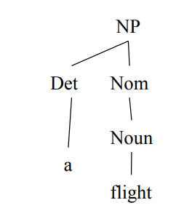
Context-Free Rules and Trees
CFG (or Phrase-Structure Grammar):
– The most commonly used mathematical system for modeling constituent structure in English and other NLs
– Terminals and non-terminals
– Derivation
– Parse tree
– Start symbol

Slide 13
Context-Free Grammars
Context-free grammars (CFGs) also known as
Phrase structure grammars
Backus-Naur form
Consist of
Rules
Terminals
Non-terminals

Slide 14
Context-Free Grammars
Terminals
words
Non-Terminals
The constituents in a language Such as noun phrases, verb phrases and sentences
Rules
Rules are equations that consist of a single non-terminal
In each context-free rule, the item to the right of the arrow (→) is an ordered list of one or more terminals and non-terminals; to the left of the arrow is a single non-terminal symbol expressing some cluster or generalization.

Slide 15
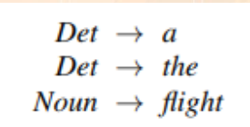

Slide 16
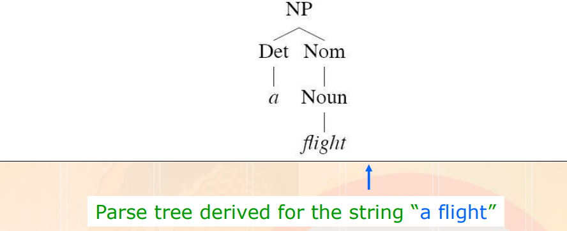
A CFG can be thought of in two ways
• A device for generating sentences
• A device for assigning structure to a sentence

Slide 17
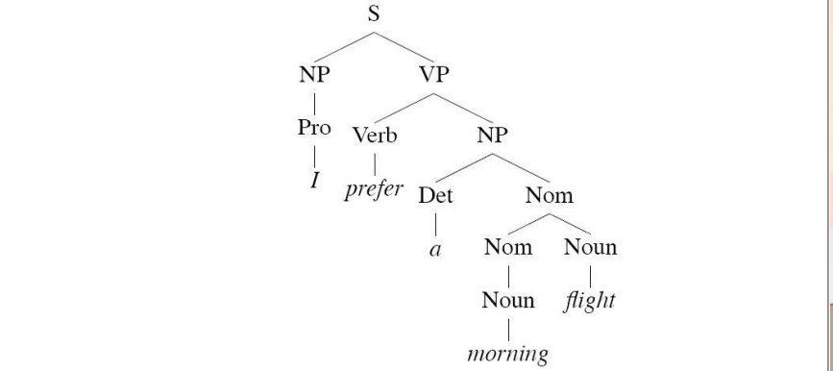
A CFG has a start symbol S
❑ Rules that expand S are called high-level rules
• S → NP VP I prefer a morning flight
• VP → Verb NP prefer a morning flight
• VP → Verb NP PP leave Boston in the morning
• VP → Verb PP leaving on Thursday
• PP → Preposition NP from Los Angeles

Slide 18
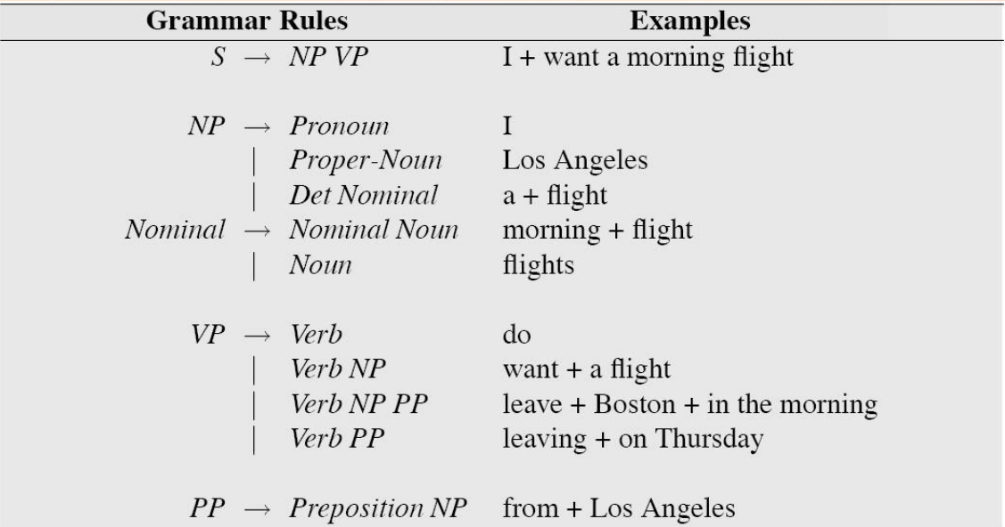
Grammar for L0

Slide 19
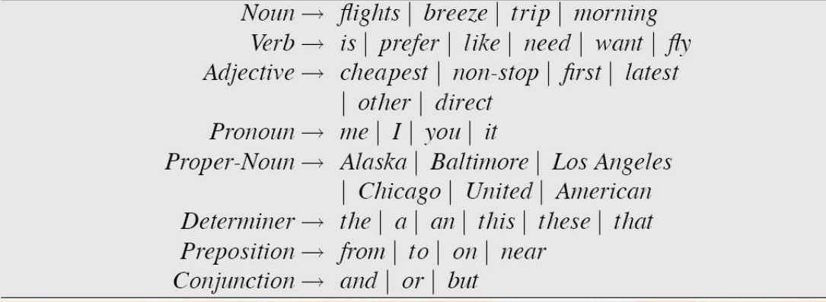
Lexican Rule for L0

Slide 20
Formally, a CFG is a 4-tuple N, Σ, P, Si, where
N is a set of non-terminal symbols (e.g., syntactic categories)
Σ a set of terminal symbols (e.g., words)
P a set of productions (rules) of the form A → α, where
A is a non-terminal, and
α is a string of symbols from the set (Σ ∪ N)*(i.e., both terminals and non-terminals)
a designated start symbol S

Slide 21
Context-Free Rules and Trees
• Bracket notation of parse tree (see next page)
• Grammatical vs. ungrammatical sentences
• The use of formal languages to model NLs is called generative grammar, since the language is defined by the set of possible sentences “generated” by the grammar.
• The formal definition of a CFG is a 4-tuple: (A set of non-terminal symbols, a set of terminal symbols, a set of rules, a start symbol).

Slide 22
Parsing
Parsing is the process of taking a string and a grammar and returning a (or multiple) parse tree(s) for that string
It is completely analogous to running a finite-state transducer with a tape
It’s just more powerful
there are languages we can capture with CFGs that we can’t capture with finite-state machines.

Slide 23
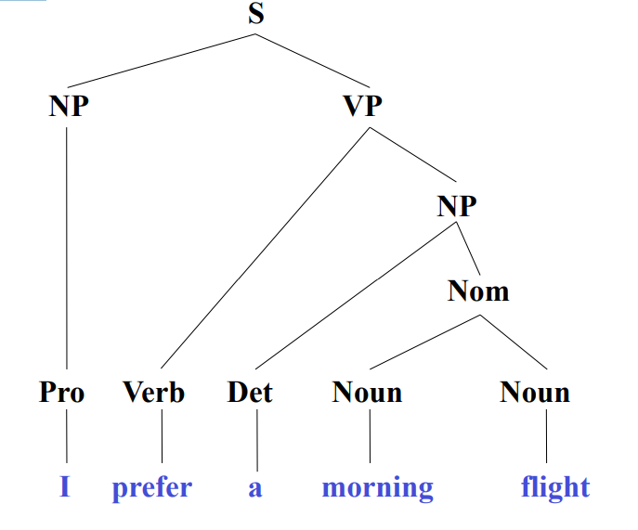
Bracketed Notation
[S [NP [PRO I]] [VP [V prefer] [NP [Det a] [Nom [N morning] [N flight] ] ] ] ]

Slide 24
Sentence-Level Constructions
There are a great number of possible overall sentence structures, but four are particularly common and important:
– Declarative structure, imperative structure, interrogative structure (yes-n-no-question structure), and wh-question structure.
• Sentences with declarative structure
– A subject NP followed by a VP
• The flight should be eleven a.m. tomorrow.
• I need a flight to Seattle leaving from Baltimore making a stop in Minneapolis.
• The return flight should leave at around seven p.m.
• I would like to find out the flight number for the United flight that arrives in San Jose around ten p.m.
• I’d like to fly the coach discount class.
• I want a flight from Ontario to Chicago.
• I plan to leave on July first around six thirty in the evening. – S → NP VP

Slide 25
Sentence with imperative structure
– Begin with a VP and have no subject.
– Always used for commands and suggestions
• Show the lowest fare.
• Show me the cheapest fare that has lunch.
• Give me Sunday’s flight arriving in Las Vegas from Memphis and New York City.
• List all flights between five and seven p.m.
• List all flights from Burbank to Denver.
• Show me all flights that depart before ten a.m. and have first class fares.
• Show me all the flights leaving Baltimore.
• Show me flights arriving within thirty minutes of each other.
• Please list the flights from Charlotte to Long Beach arriving after lunch time.
• Show me the last flight to leave. – S → VP

Slide 26
Sentences with yes-no-question structure
– Begin with auxiliary, followed by a subject NP, followed by a VP.
• Do any of these flights have stops?
• Does American’s flight eighteen twenty five serve dinner?
• Can you give me the same information for United?
– S → Aux NP VP

Slide 27
The wh-subject-question structure
– Identical to the declarative structure, except that the first NP contains some wh-word.
• What airlines fly from Burbank to Denver?
• Which flights depart Burbank after noon and arrive in Denver by six p.m.?
• Which flights serve breakfast?
• Which of these flights have the longest layover Nashville?
– S → Wh-NP VP
• The wh-non-subject-question structure
• What flights do you have from Burbank to Tacoma Washington?
– S → Wh-NP Aux NP VP

Slide 28
The Noun Phrase
View the NP as revolving around a head, the central noun in the NP.
NP Structure
➔ All the morning flights from Denver to Tampa leaving before 10
 Clearly this NP is really about flights. That’s the central critical noun in this NP. Such word is called as the
head.
 We can divide this kind of NP into the stuff that can come before the head, and the stuff that can come after it.
– The syntax of English allows for both pre-nominal (pre-head) modifiers and post-nominal (post-head) modifiers.

Slide 29
NPs can begin with a determiner,
Determiners can be
 Simple lexical items: the, this, a, an, etc.
 A car
 Or simple possessives
 John’s car
 Or complex recursive versions of that
 John’s sister’s husband’s son’s car
– a stop, the flights, that fare, this flight, those flights, any flights, some flights (can be complex: some but not all flights)
• Determiners can be optional,
– Show me flights from San Francisco to Denver on weekdays.
• Mass nouns don’t require determiners.
– Substances, like water and snow
– Abstract nouns, music, homework,

Slide 30
Predeterminers:
– Word classes appearing in the NP before the determiner
• all the flights, all flights
• Postdeterminers:
– Word classes appearing in the NP between the determiner and the head noun
• Cardinal numbers: two friends, one stop
• Ordinal numbers: the first one, the next day, the second leg, the last flight, the other American flight, and other fares
• Quantifiers: many fares
– The quantifiers, much and a little occur only with noncount nouns.

Slide 31
The Noun Phrase Before the Head Noun
• Adjectives occur after quantifiers but before nouns.
– a first-class fare, a nonstop flight, the longest layover, the earliest lunch flight
• Adjectives can be grouped into a phrase called an adjective phrase or AP.
– AP can have an adverb before the adjective
• the least expensive fare

Slide 32
The Noun Phrase After the Head Noun
A head noun can be followed by postmodifiers.
– Prepositional phrases
• All flights from Cleveland
– Non-finite clauses
• Any flights arriving after eleven a.m.
– Relative clauses
• A flight that serves breakfast

Slide 33
PP postmodifiers
– any stopovers [for Delta seven fifty one]
– all flight [from Cleveland] [to Newark]
– arrival [in San Jose] [before seven a.m.]
– a reservation [on flight six oh six] [from Tampa] [to Montreal]
– Nominal → Nominal PP (PP) (PP)

Slide 34
The three most common kinds of non-finite postmodifiers are the
gerundive (-ing), -ed, and infinitive form.
– A gerundive consists of a VP beginning with the gerundive (-ing)
• any of those [leaving on Thursday]
• any flights [arriving after eleven a.m.]
• flights [arriving within thirty minutes of each other]
Nominal → Nominal GerundVP
GerundVP → GerundV NP | GerundV PP | GerundV | GerundV NP PP
GerundV → being | preferring | ariving | leaving | …
– Examples of two other common kinds
• the last flight to arrive in Boston
• I need to have dinner served
• Which is the aircraft used by this flight?

Slide 35
A postnominal relative clause
– is a clause that often begins with a relative pronoun (that and who are the
most common).
– The relative pronoun functions as the subject of the embedded verb,
• a flight that serves breakfast
• flights that leave in the morning
• the United flight that arrives in San Jose around ten p.m.
• the one that leaves at ten thirty five
Nominal → Nominal RelClause
RelClause → (who | that) VP

Slide 36
Various postnominal modifiers can be combined,
– a flight [from Phoenix to Detroit] [leaving Monday evening]
– I need a flight [to Seattle] [leaving from Baltimore] [making a stop in
Minneapolis]
– evening flights [from Nashville to Houston] [that serve dinner]
– a friend [living in Denver] [that would like to visit me here in Washington
DC]

Slide 37
Agreement
Constraints that hold among various constituents.
 For example, in English, determiners and the head nouns in NPs have to agree in their number.
 Which of the following cannot be parsed by the rule
NP - Det Nominal ?
(O) This flight
(O) Those flights
(X) This flights
(X) Those flight

Slide 38
Problem
 Our earlier NP rules are clearly deficient since they don’t capture the agreement constraint
 NP Det Nominal
 Accepts, and assigns correct structures, to grammatical examples (this flight)
 But its also happy with incorrect examples (*these flight)
 Such a rule is said to overgenerate.

Slide 39
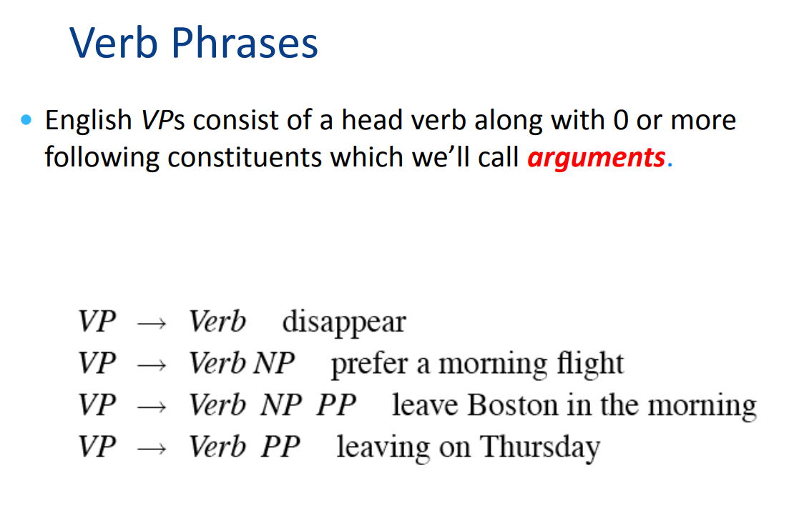

Slide 40
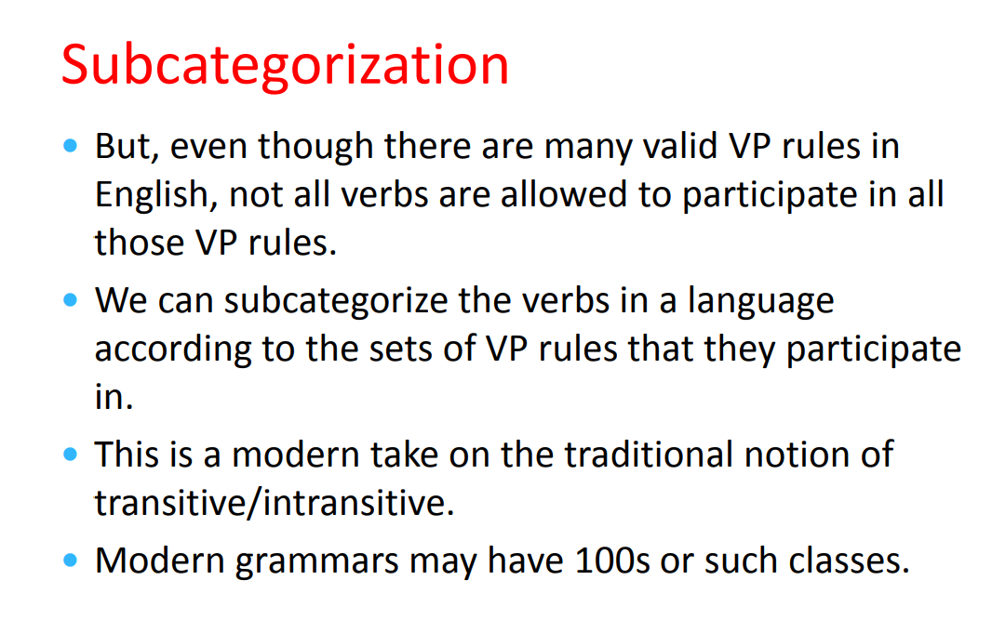

Slide 41
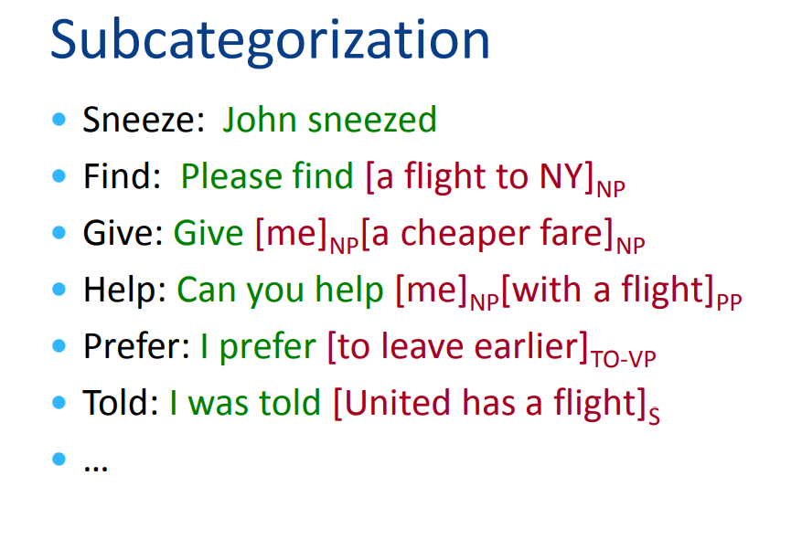

Slide 42
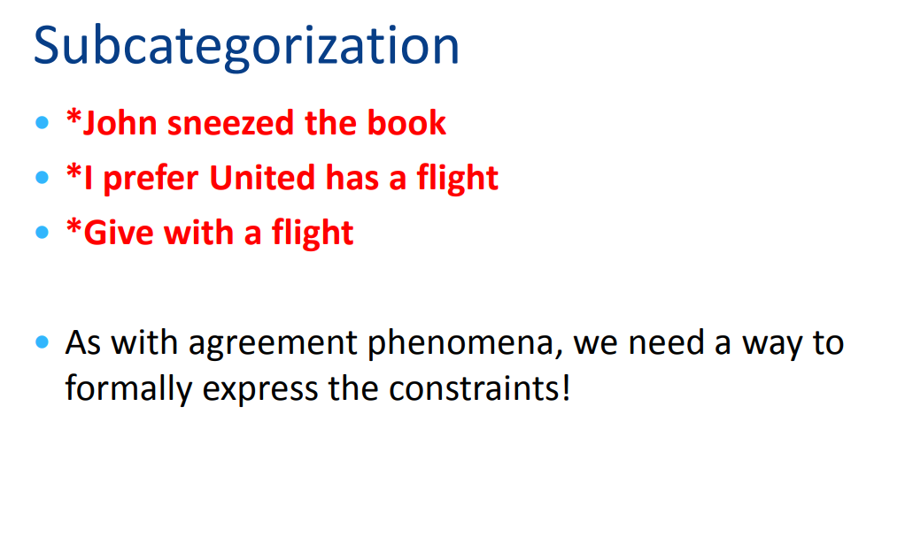

Slide 43
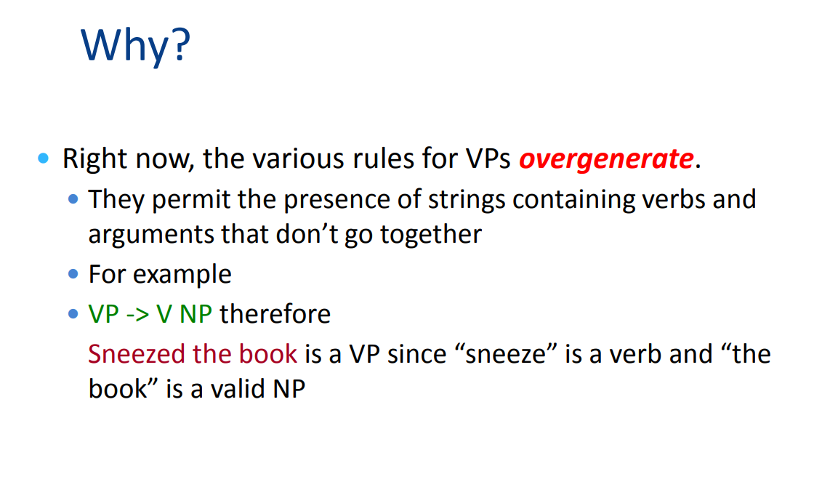

Slide 44
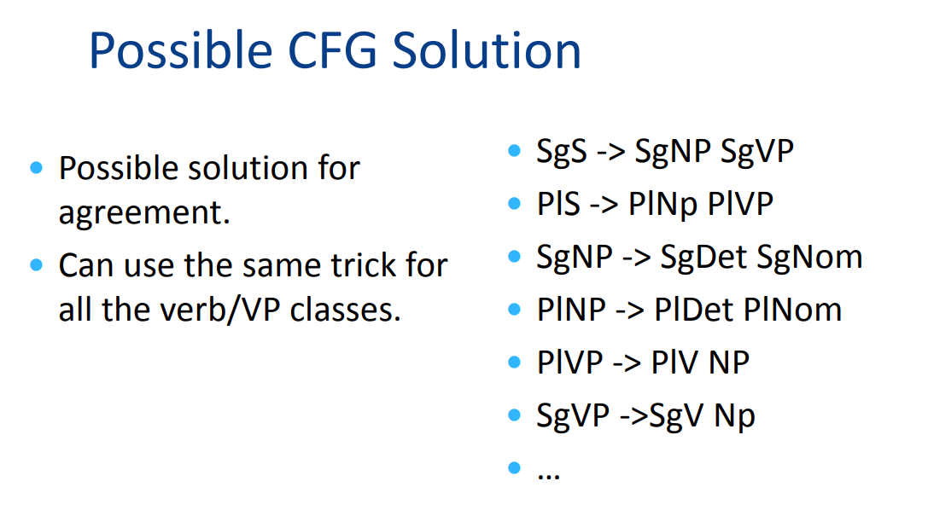

Slide 45
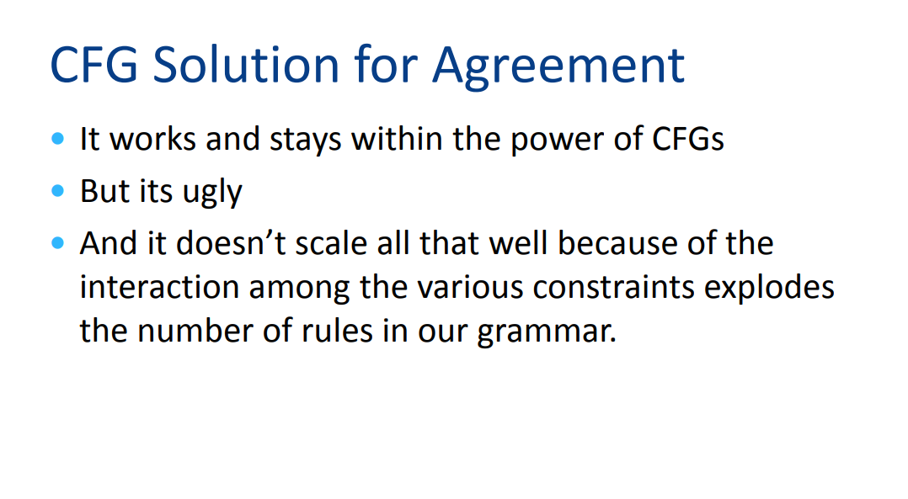

Slide 46
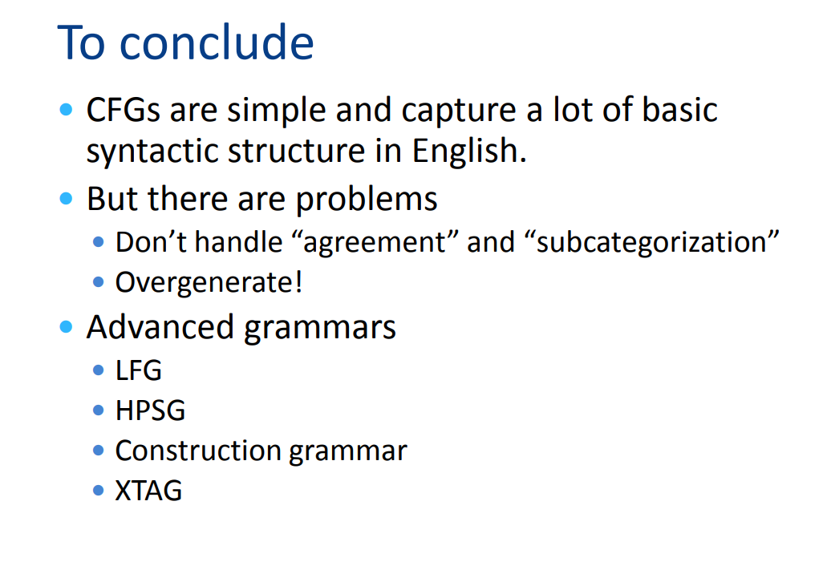

Slide 47
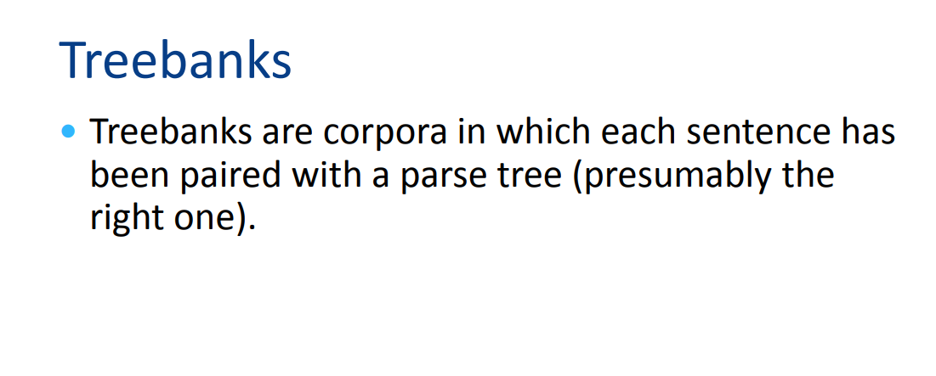

Slide 48
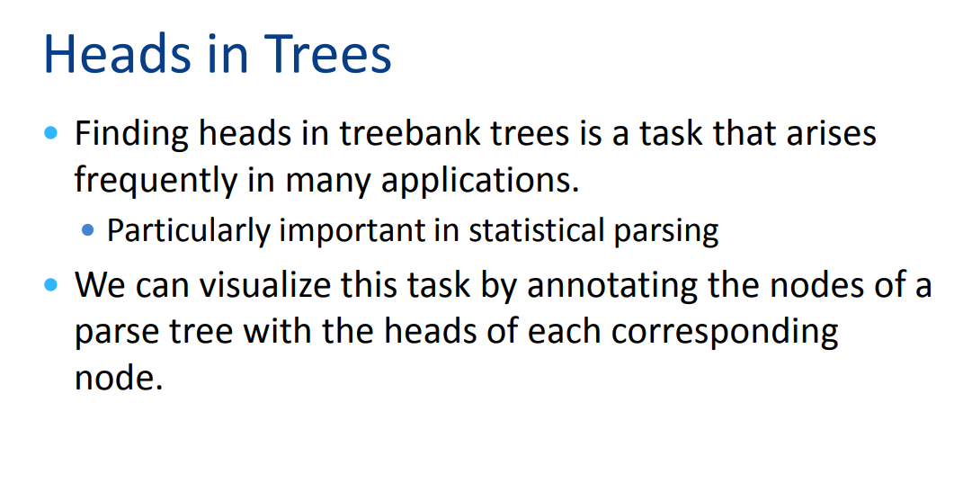

Slide 49
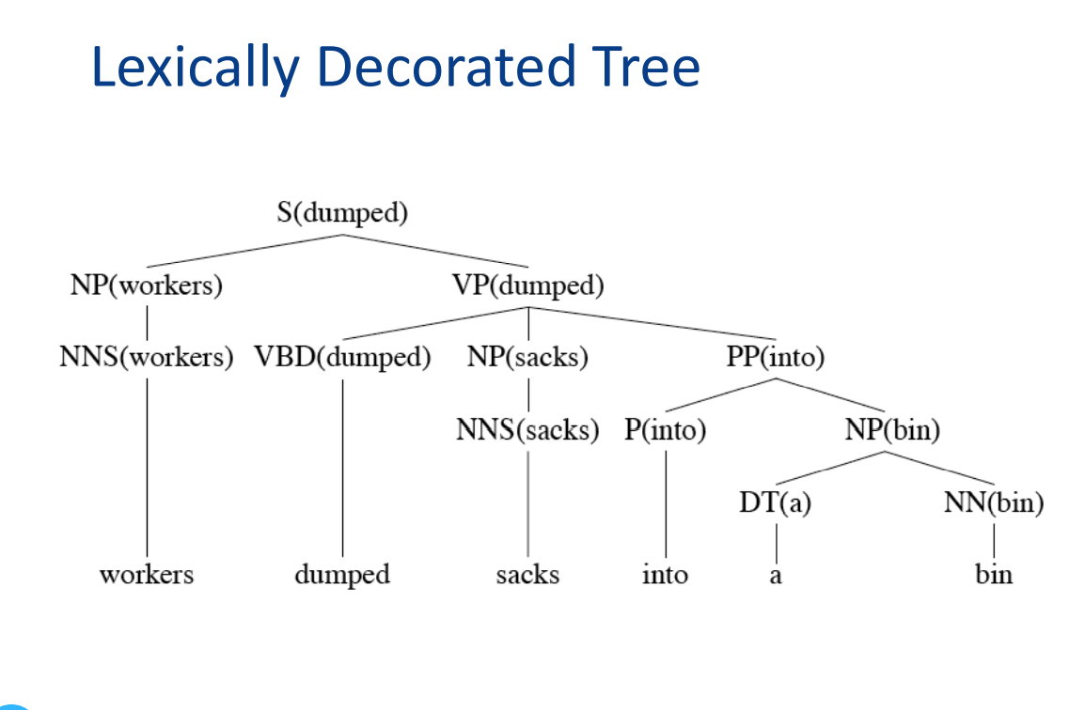

Slide 50
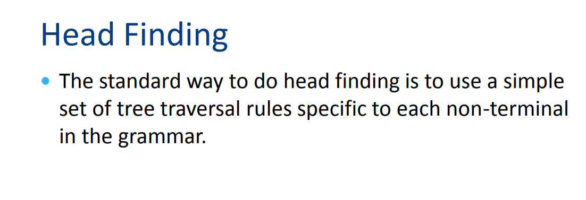

Slide 51
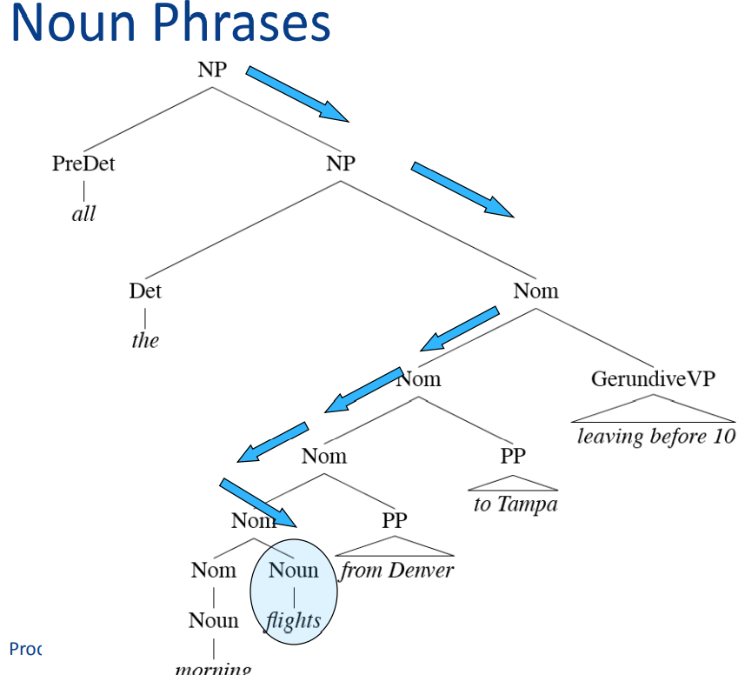

Slide 52
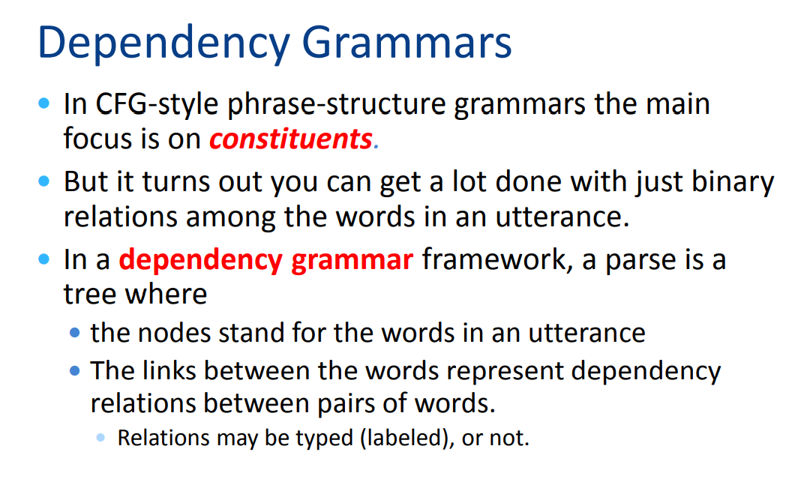

Slide 53
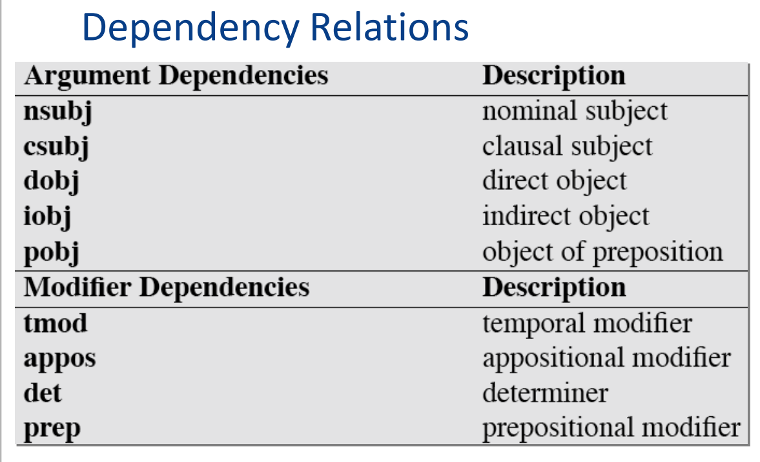

Slide 54
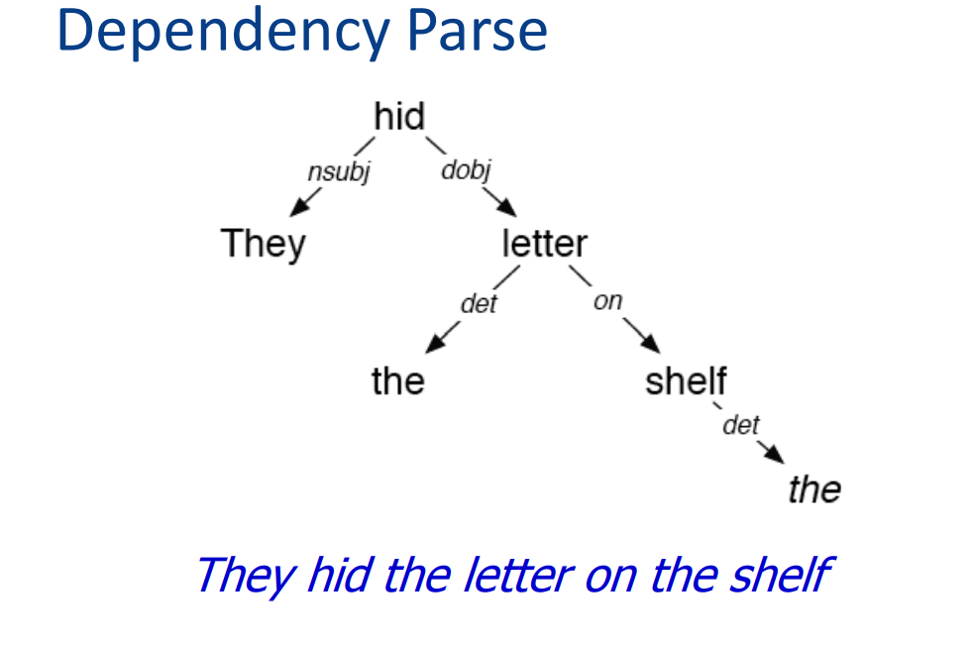

Slide 55
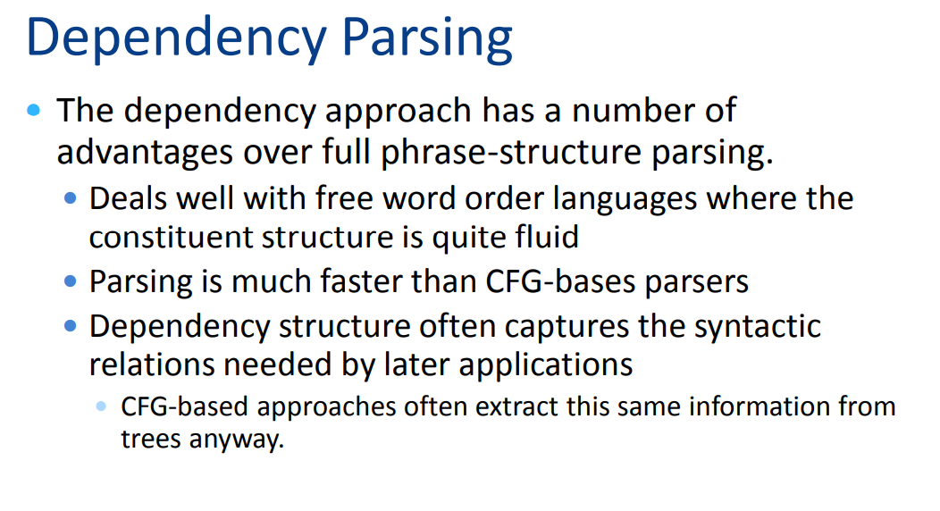

Slide 56
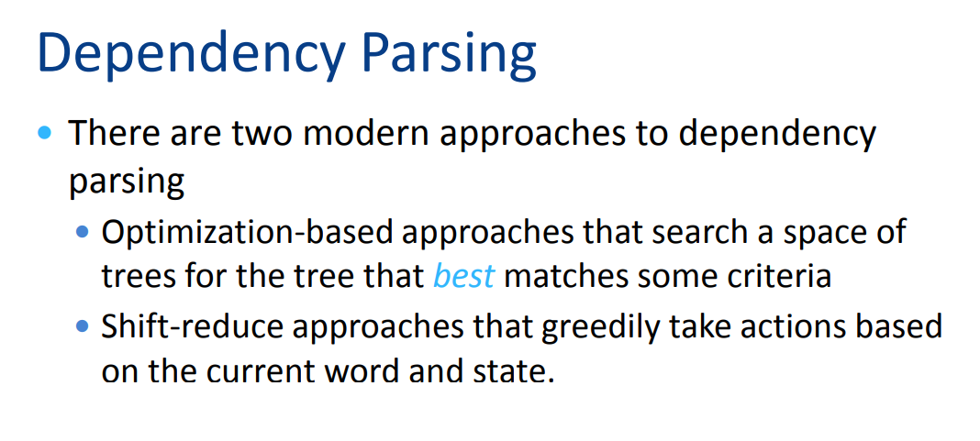

Slide 57
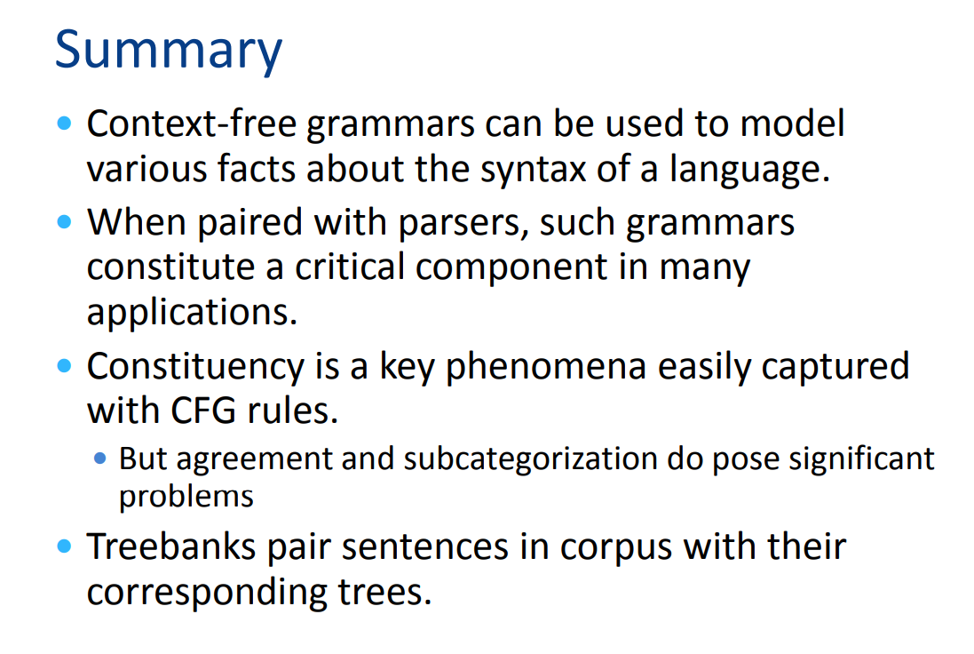

Slide 58
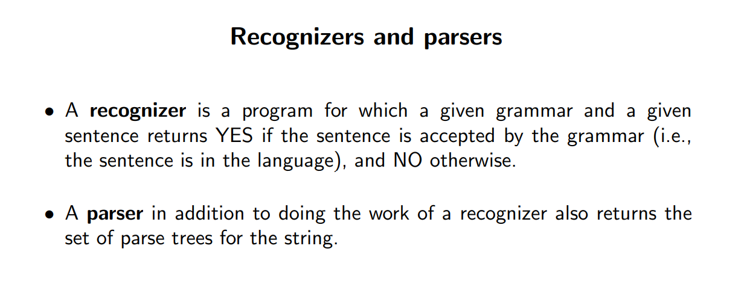

Slide 59
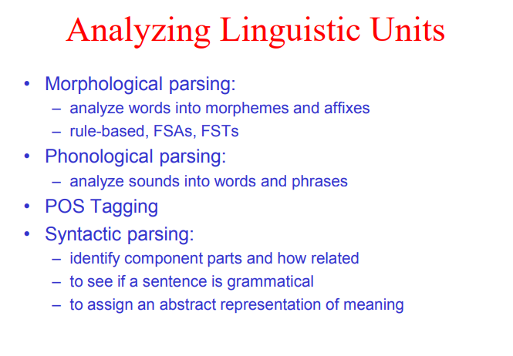

Slide 60
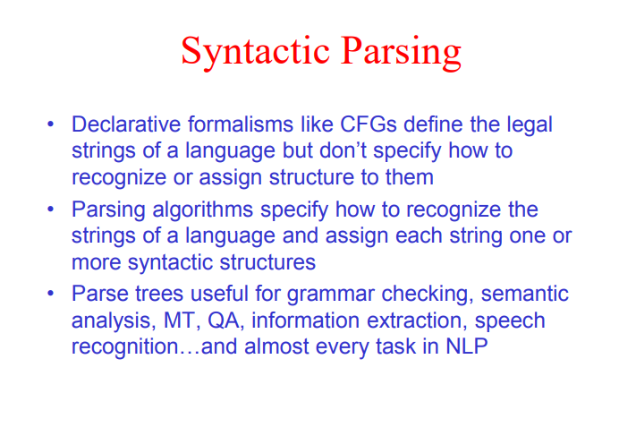

Slide 61
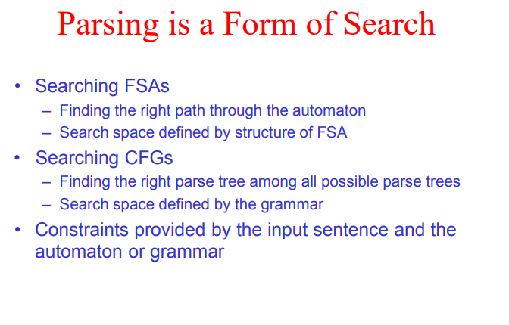

Slide 62
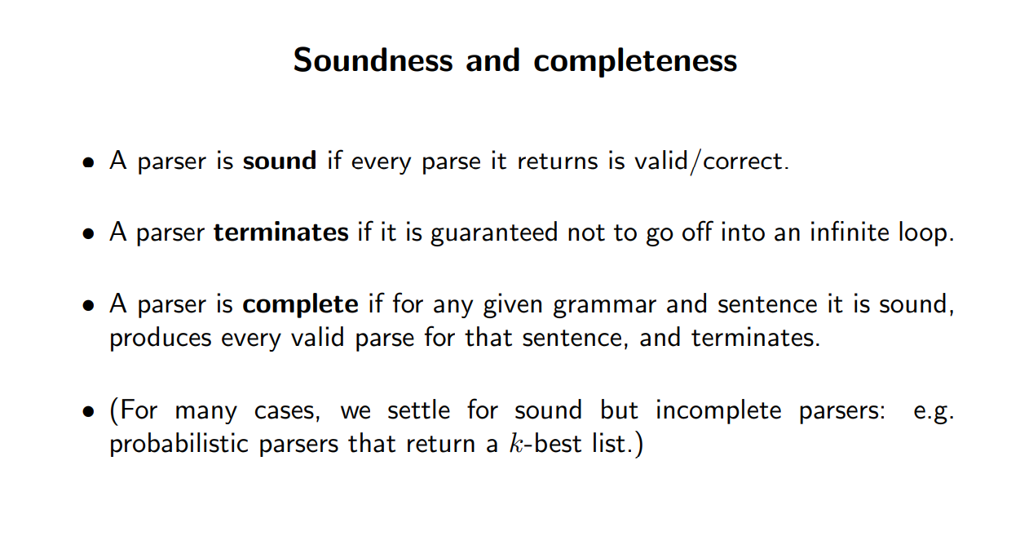

Slide 63
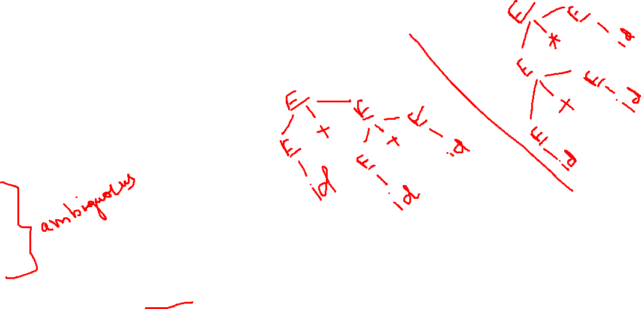
Parse Tree
Left-most order of derivation
Right –Most order of derivation
E-E+E
E-E*E
E-id
We find that for the string id + id*id there exists more than one parse tree??

Slide 64
Consider a grammar having the following productions:
S- aSbS/bSaS/e

Slide 65

If a grammer G is unambiguous, then for every w in L(G) there exists exactly one parse tree. Hence, there exists one left most order of derivation and one right most order of derivation for every w in L(G). But if grammer G is ambiguous, then for some w in L(G), there exists more than one parse tree. Therefore there is more than one left most order of derivation and equivently , there is more than on eright-most order of derivation.

Slide 66
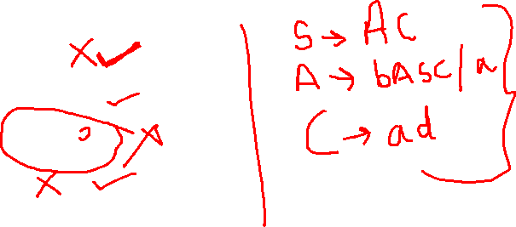
REDUCTION OF GRAMMER
Reduction of a grammar refers to the identification of those grammar symbols (“Useless grammar symbols”)and hence those productions , that do not play any role in the derivation of w in L(G) and which we eliminate from grammar.
S- AC/SB
A- bASC/a
B- aSB/bbc
C- Bc/ad

Slide 67
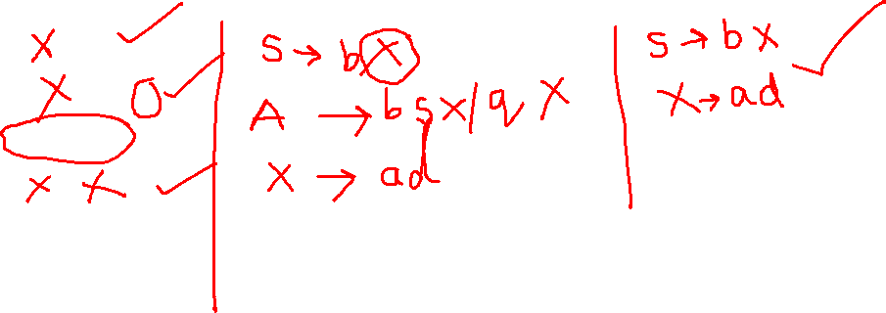
S- aB/bX
A- Bad/ bSX/q
B- aSB/bBX
X-SBD/aBx/ad

Slide 68
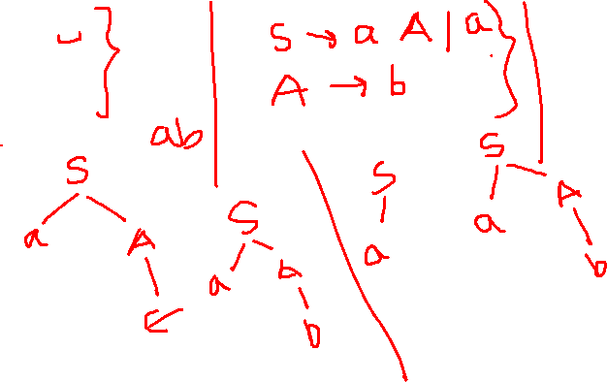
Eliminating Production
S- aA
A-b/

Slide 69
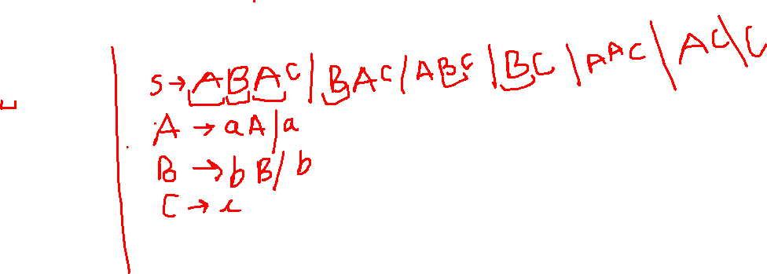
S- ABAC
A- aA/
B-bB/
C- c

Slide 70
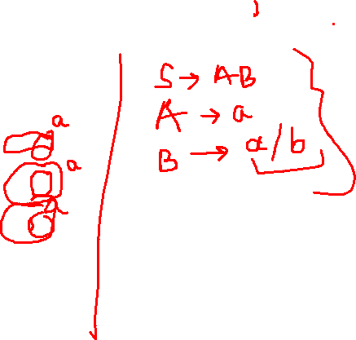
Eliminating unit Production
A production of the form A-B where A and B are both nonterminals, is called unit production. Unit production in the grammar increase the cost of derivations.
S- AB
A-a
B- C/b
C-D
D-E
E-a

Slide 71
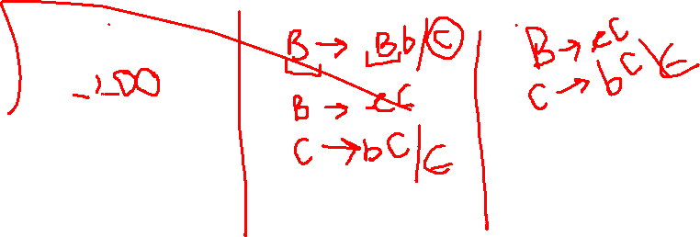
Eliminating Left Recursion
S- aBDh
B- Bb/c
D- EF
E-g/
F-f/

Slide 72
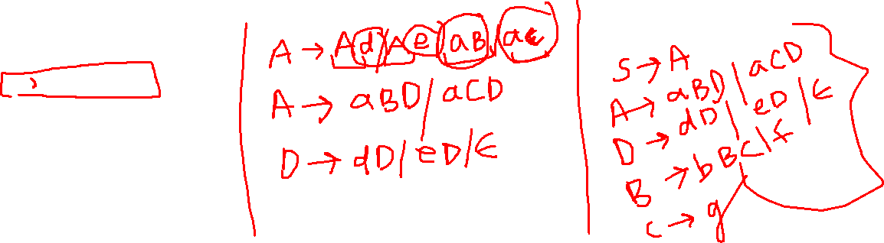
S- A
A- Ad/Ae/aB/aC
B- bBC/f
C- g

Slide 73
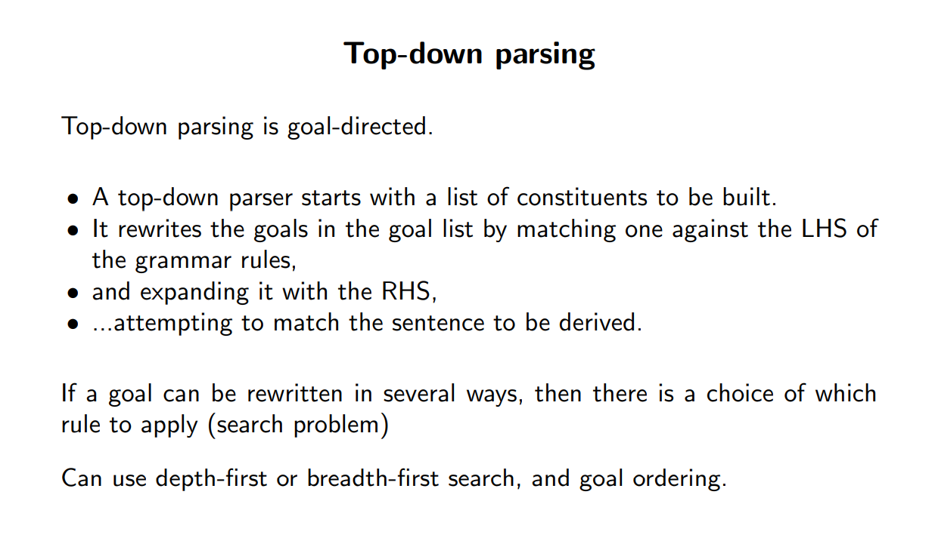

Slide 74
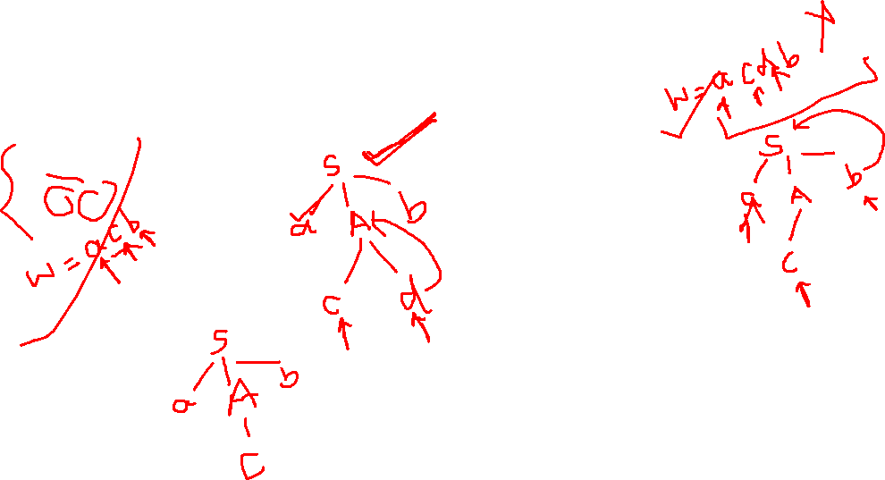
S- aAb
A- cd/c

Slide 75
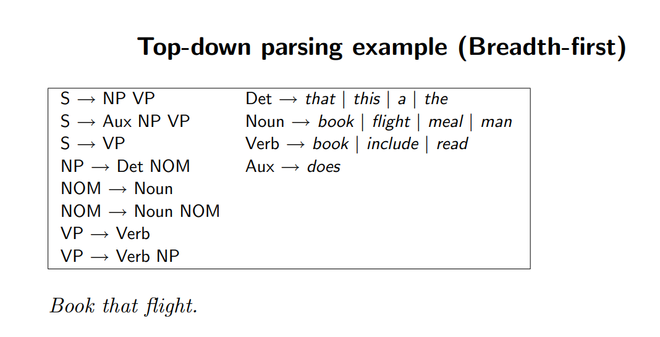

Slide 76
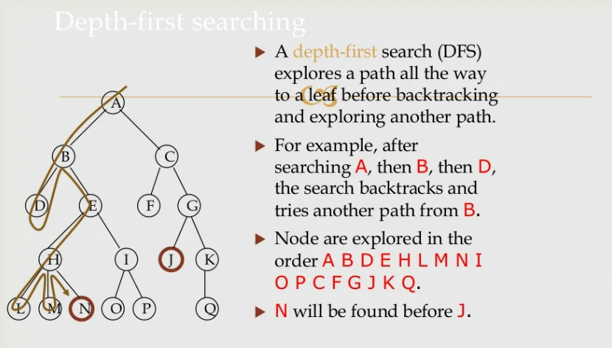

Slide 77
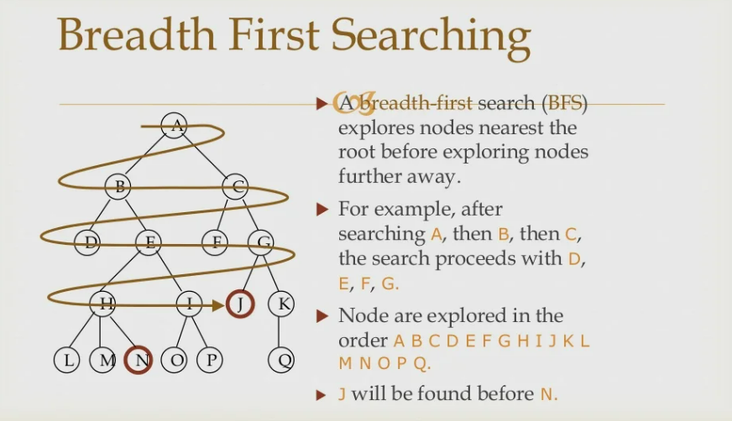

Slide 78
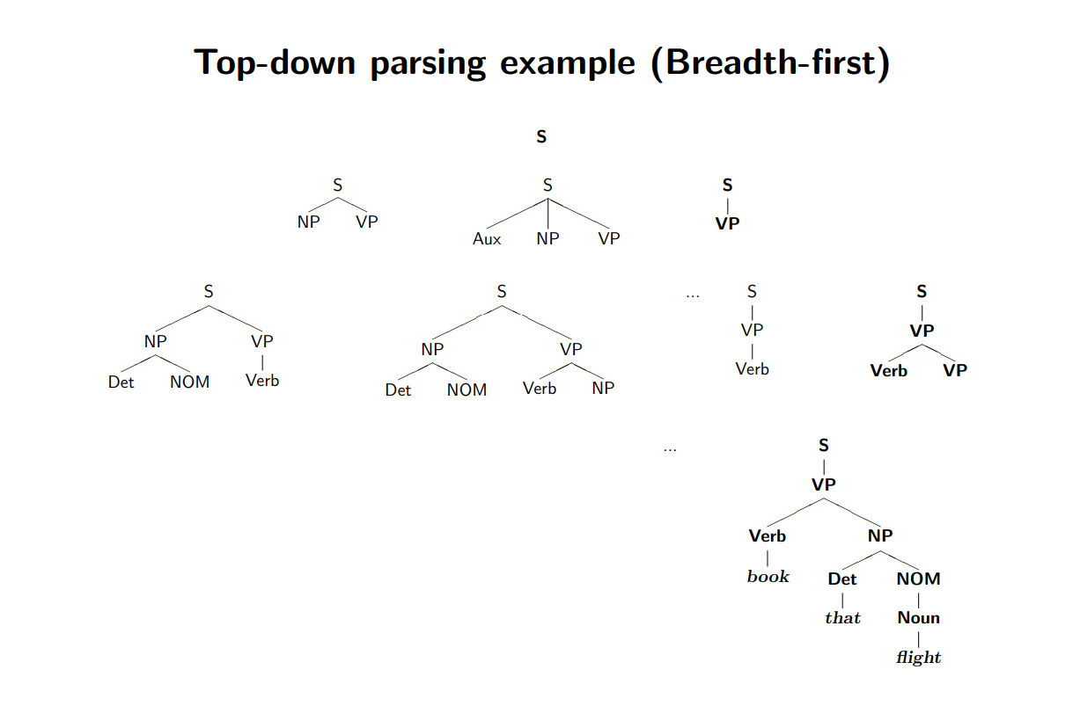

Slide 79
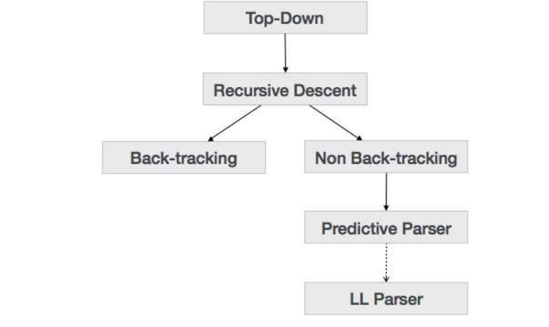


Slide 80

Classification of Top-Down Parsing –
1. With Backtracking: Brute Force Technique
2. Without Backtracking:
Recursive Descent Parsing
Predictive Parsing or Non-Recursive Parsing or LL(1) Parsing or Table Driver Parsing
Recursive Descent Parsing –
Whenever a Non-terminal spend the first time then go with the first alternative and compare it with the given I/P String
If matching doesn’t occur then go with the second alternative and compare with the given I/P String.
If matching is not found again then go with the alternative and so on.
Moreover, If matching occurs for at least one alternative, then the I/P string is parsed successfully.
LL(1) or Table Driver or Predictive Parser –
In LL1, first L stands for Left to Right and second L stands for Left-most Derivation. 1 stands for a number of Look Ahead tokens used by parser while parsing a sentence.
LL(1) parsing is constructed from the grammar which is free from left recursion, common prefix, and ambiguity.
LL(1) parser depends on 1 look ahead symbol to predict the production to expand the parse tree.
This parser is Non-Recursive.

Slide 81
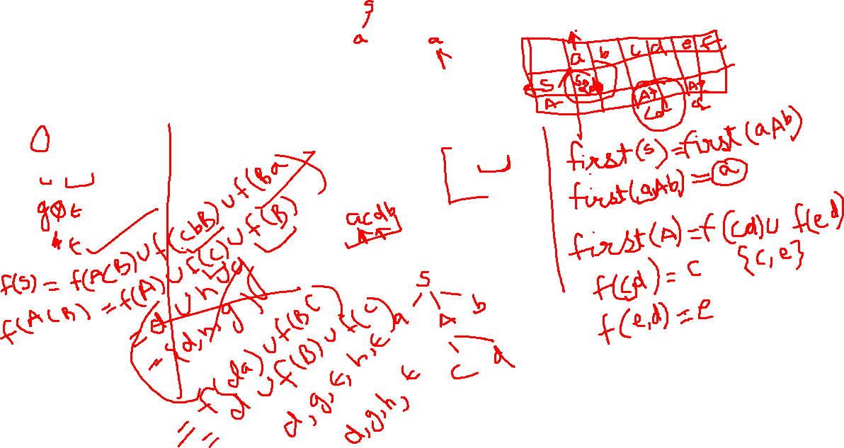
Predictive parser
S- ACB/CbB/Ba
A- da/BC
B-G/e
C-h/e
S- aAb
A- cd/ef

Slide 82
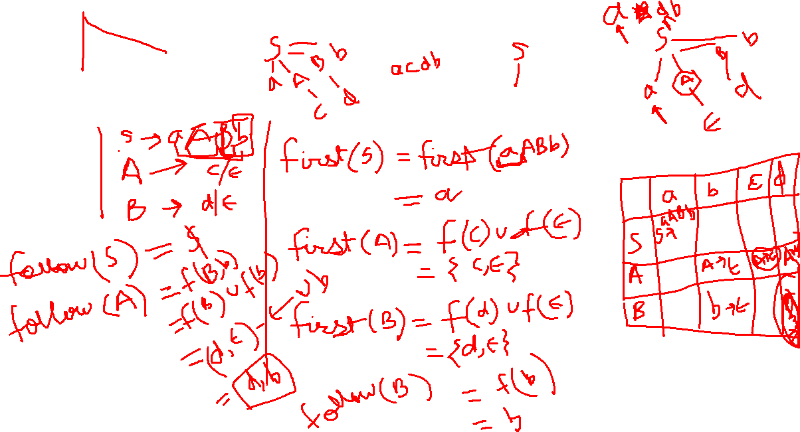
S- aAb
A- cd/ef

Slide 83
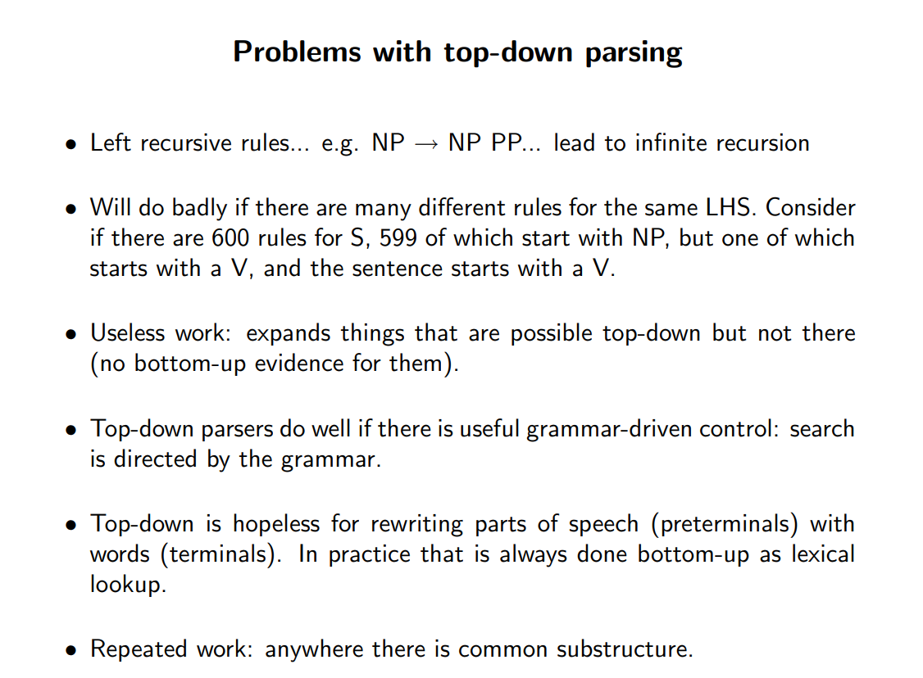
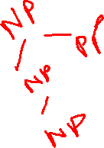


Slide 84



Slide 85




Slide 86



Slide 87



Slide 88



Slide 89


Slide 90


